Slide 1
Composition of semen

Slide 2
Semen is composed from:
Spermatozoa – testes
Seminal plasma – accessory glands (vesicular glands, bulbourethral glands and prostate gland)
In bulls, the greatest contribution to the fluid volume of semen is from the vesicular glands, with minor contributions from the prostate gland and bulbourethral glands
In boars, there are greater contributions from the prostate and bulbourethral glands, with a smaller proportion from the vesicular glands

Slide 3
Semen is composed from
These differences are reflected in the chemical composition of semen
Bull semen is higher in fructose and sorbitol, which comes from the vesicular glands
Whereas boar semen is higher in most minerals, the major source of these being the prostate gland

Slide 4
Spermatozoa
The concentration (no. /ml) of spermatozoa in an ejaculate of semen is approximately
150 million for stallions,
200 million for boars,
1.2 billion for bulls,
2 billion for rams
Theoretically, 50% of the spermatozoa in a given ejaculate will contain X chromosomes and 50% Y chromosomes
Approximately 60% to 70% of the spermatozoa in semen are expected to be progressively motile
Average speed of 6 mm per minute

Slide 5
Spermatozoa
In high-quality semen, 80% to 90% of the spermatozoa will have normal morphology
Concentration
motility percent
morphology
Spermatozoa of bulls have an overall length of 60µ to 70µ
The head is 8µ to 10µ long
The head is flattened, about 4µ wide and 0.5µ thick
Both boars and rams have sperm of similar size, while sperm of stallions are smaller (about 50µ in length)

Slide 6
Normal Morphology
The normal spermatozoon is composed of a head and a tail that is divided into a mid-piece, main-piece, and end-piece
The important components of the head include the nucleus, containing the genetic code, which is the sire's contribution to a new offspring
The acrosome covers the anterior part of the nucleus and contains enzymes needed for penetration of the corona radiata and zona pellucida during fertilization
If the acrosome is malformed, damaged, or missing, the spermatozoon will not be able to participate in fertilization
During aging, the acrosome becomes loosened from the nucleus starting at the apical ridge

Slide 7
Normal Morphology
The post-nuclear cap, covering the posterior portion of the nucleus,
The point where the tail joins the head contains the proximal centriole and is called the implantation region
The head and tail become separated at this point during fertilization
Similar separation is sometimes seen in heat-damaged semen

Slide 8
Normal Morphology
The tail
(mid-piece, main-piece, end-piece)
The mid-piece, a thickened portion of the tail some 8µ to 10µ long
located just posterior to the proximal centriole
The mid-piece is characterize by :
mitochondrial sheath and mitochondria : contains enzymes which convert fructose and other energy substrates into high-energy compounds that can be used by spermatozoa (for movement)

Slide 9
Normal Morphology
The tail
A major feature of the tail is the axial filaments.
The axial filament is a small bundle of tiny fibrils that starts at the proximal centriole and runs through the entire tail
In mid-piece the axial filaments consist from:
9 course outer fibrils
9 double inner fibrils
2 central fibrils

Slide 10
Normal Morphology
The main-piece (40µ to 50µ long)
The layers of main-piece are :
9 double inner fibrils
2 central fibrils
The end-piece (3µ long)
does not have a protective sheath.
The layer of end-piece :
2 central fibrils

Slide 11
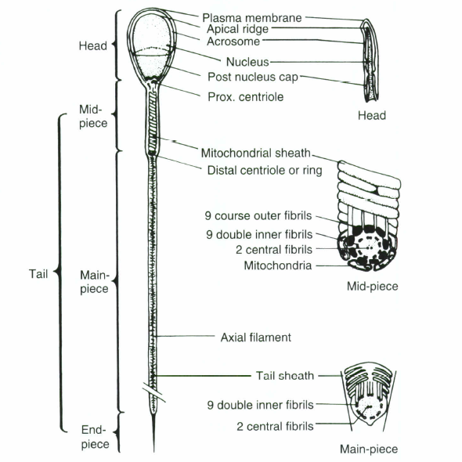

Slide 12
The tail
The main function of the tail is movement of the sperm (how)?
Contractions of these fibrils cause a lashing of the tail, which propels the spermatozoon progressive forward
Contractions start at the proximal centriole proceeding sequentially around the perimeter fibrils and rhythmically down the tail
These two movements causing a rotation of the entire spermatozoon as it moves progressively forward

Slide 13
SEMINAL PLASMA
The fluid portion of semen is seminal plasma
The source of seminal plasma is the accessory glands
Also some times from the epididymides and vasa deferentia
Seminal plasma serves as a buffered, nutrient medium which suspends and maintains the fertility of spermatozoa
Seminal plasma is slightly acidic in bulls and rams and slightly alkaline in boars and stallions
The osmotic pressure of seminal plasma is similar to blood (equivalent to physiological saline-0.9% sodium chloride)

Slide 14
SEMINAL PLASMA
A number of organic and inorganic compounds are in solution in seminal plasma.
Proteins
Several proteins that have a relationship to fertility have been found in seminal plasma
Glycosaminoglycan (GAG)-binding proteins , its role during capacitation
The binding affinity of ejaculated sperm for glycosaminoglycan (via binding proteins) corresponds to fertility in bulls
Based on profiles of seminal proteins, predicted fertility for bulls
The fertility decline with successive ejaculates over a period

Slide 15
SEMINAL PLASMA
Inorganic Ions
Sodium and chlorine are the principal inorganic ions in seminal plasma
Smaller quantities of calcium and magnesium are found
Potassium, which is present in substantial amounts in whole semen, is more concentrated in spermatozoa than in the fluid suspending the spermatozoa
Thus, when spermatozoa are concentrated, as in the epididymis, the potassium-to-sodium ratio is higher
These inorganic ions are important to the viability of spermatozoa, possibly through their effect on the integrity of the sperm cell membrane

Slide 16
SEMINAL PLASMA
Buffering Agents
Organic ions that serve as buffering agents are found in seminal plasma
The principal organic ion is bicarbonate
It is produced by the vesicular glands and functions as a buffering agent, against changes in the pH of semen
Buffers are not found in sufficient quantities to prevent a reduction in pH when semen is maintained in storage
Therefore, good semen diluters must be used to provide sufficient buffering capacity for long-term storage

Slide 17
SEMINAL PLASMA
Energy Substrates
Several organic compounds that serve primarily as energy substrates for spermatozoa are found in seminal plasma
The principal ones are fructose, sorbitol, and glycerylphosphorylcholine (GPC)
Fructose (a simple sugar) and sorbitol (a sugar alcohol) are produced by the vesicular glands, whereas GPC is produced in the epididymides
All are unique in that they are not found in substantial quantities elsewhere in the body
Fructose can be used by spermatozoa as an energy substrate under the anaerobic conditions of storage and the aerobic conditions found in the female tract

Slide 18
SEMINAL PLASMA
Sorbitol and GPC can be utilized only aerobically
GPC must be acted on by an enzyme found in the female tract before it can be utilized
This enzyme splits the choline from the rest of the molecule, forming glycerylphosphate, which can be metabolized as an energy substrate
Lactic acid, a by-product of the anaerobic metabolism of fructose builds up in semen that is being stored and theoretically can be used as an energy substrate when placed in aerobic conditions.

Slide 19
SEMINAL PLASMA
Fructose is found in high concentrations in bull and ram semen but is much lower in both boar and stallion semen
The low concentration of fructose in boar and stallion semen may contribute to the problems of storing semen from these species

Slide 20
SEMINAL PLASMA
Other Organic Compounds
Compounds found in seminal plasma in rather large concentrations but not used as energy substrates are inositol and citric acid
Both are produced by the accessory glands
Ergothionine is found in the semen of boars and stallions
These compounds are not found in substantial amounts elsewhere in the body
( All these products play role for sperm metabolism)

Slide 21
SEMINAL PLASMA
Fatty compounds
Prostaglandins and vesiglandins and phospholipids
( All these products play role for sperm metabolism)
Vitamins
Vitamin C and B complex
( All these vitamins play role as a co factor for sperm metabolism)

